Slide 1



Introduction to Research
Postgraduate Diploma in
Development Finance – Research Orientation
Dr Pieter Opperman

Slide 2
WHY RESEARCH?
Many (new) issues and subjects about which we have incomplete knowledge.
Need for growth.
Acquisition of knowledge will benefit society.

Slide 3
WHY RESEARCH?
The presence of foreign banks in Africa has increased considerably in recent decades. From 1995 to 2009, cross-border bank branches or subsidiaries in Africa have increased from 120 to 227, resulting in the share of foreign banks rising from 29% to 51% (Beck et al., 2014).

Slide 4
WHY RESEARCH?

Slide 5
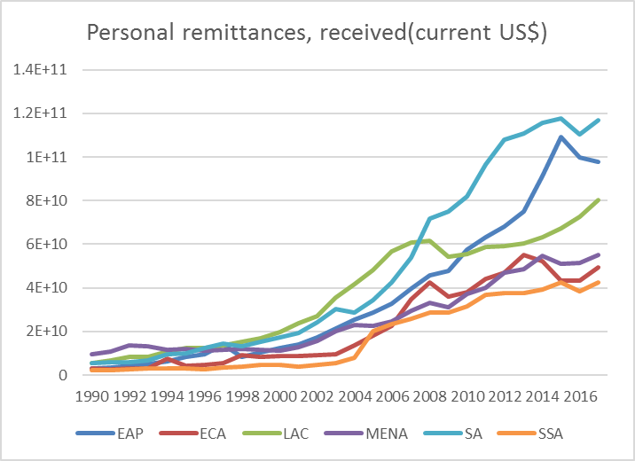
Personal remittances, received

Slide 6
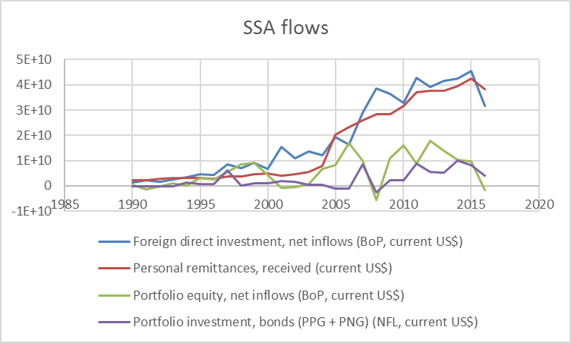
Overview of private capital flows

Slide 7
WHY RESEARCH?
Credit to government and state owned enterprises as a percentage of GDP has increased in sub-Saharan Africa countries in recent decades from an average of 3.29% in 1990 to 7.20% in 2014. In 1990, Lesotho was the only country where credit to government as a percentage of GDP exceeded 10% with eight Sub-Saharan African countries exceeding that percentage in 2014.

Slide 8
HOW TO RESEARCH
Appreciate that the research process is often relatively unstructured and frequently unpredictable!

Slide 9
INTRODUCTION TO RESEARCH
What is Research?
This is “a process that involves obtaining scientific knowledge by means of various objective methods and procedure” (Welman et al., 2005).
Objective- indicates that these methods and procedures do not rely on personal opinions, and that specific methods are used at each stage of the research process (Welman et al., 2005).

Slide 10
INTRODUCTION TO RESEARCH
Aspects of scientific research:
Theory, data collection and data analysis
Theory deals with logical aspects of science and providing systematic explanations.
Data collection deals with observational aspects.
Data analysis examines the patterns in observations and where appropriate compares what is logically expected with what is actually observed.

Slide 11
INTRODUCTION TO RESEARCH
Research Strategy:
Qualitative and Quantitative
Quantitative: emphasizes quantification in the collection and analysis of data(Deductive; testing of theory, natural science model in particular positivism; objectivism)
Qualitative: emphasizes words, anthropology rather than quantification(inductive, generation of theory, interpretivism , constructivism)

